Slide 1
Clickable Rubrics in Blackboard
FAST EASY
EFFICIENT GRADING
Presented by: Michael Pelitera Jessica Fulton

Slide 2
3 Steps for Using a Rubric
Step 1: Create a Rubric
Step 2: Associate the Rubric with an Assignment
Step 3: Grade using a Rubric
https://help.blackboard.com/Learn/Instructor/Grade/Rubrics

Slide 3
Demonstration: Creating a Rubric in Blackboard
https://www.youtube.com/watch?v=ZDAE4MoDeQY&t=57s 1:01

Slide 4
Rubric OPTIONS

Slide 5
Choose a Rubric Type from the menu:
No Points: Provide feedback only.
Points: Each level of achievement has a single point value.
Point Range: Each level of achievement has a range of values. Enter range values from lowest to highest.
Percent: Each item's possible points determines the percentage.
Percent Range: Each level of achievement has a range of values. When you grade, you select the appropriate percentage level for a particular level of achievement. The system calculates the points earned by multiplying the weight x achievement percentage x item points.

Slide 6
Control Panel > Course Tools > Rubrics
On the Rubrics page, select Create Rubric. Type a title and optional description.
Select what type of Rubric you will add
3. Select Add Row to add a new criterion to the bottom of the grid.
4. Select Add Column to add a new level of achievement to the grid.

Slide 7
Associating Rubrics in Blackboard Learn
https://www.youtube.com/watch?v=fiio3IjWTzc&t=28s : 1:28

Slide 8
Grading with a Rubric
https://tinyurl.com/Gradingwitharubric 1:07

Slide 9
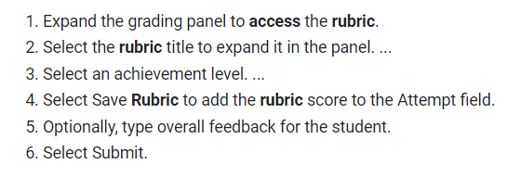
Grading an Assignment Using a Rubric

